Slide 1




Core Java
Lesson 12—Unit Testing

Slide 2


Learning Objectives
At the end of this lesson, you should be able to:
Explain the varargs feature in Java
Explain the concept of assertions
Explain the concept of unit testing Define Junit Framework
Write sample test cases using Junit framework Define Garbage Collection

Slide 3
Unit Testing
Topic 1—Varargs

Slide 4



Varargs
With the varargs feature, you can write methods that accept zero or multiple arguments.
Before the varargs feature was introduced, you either had to use overloaded method or take an
array as the method parameter.
You can use varargs if you don’t know the number of arguments that you will pass in the program.
Sample program for varargs:
class VarargsExample1
{
static void display(String... values){
System.out.println(“Sample varargs method ");
}
public static void main(String args[]){ display();//zero argument
display(“I",“am","varargs“, “method”); //four arguments
}
Output:
Sample varargs method Sample varargs method
}

Slide 5
Unit Testing
Topic 2—Assertions

Slide 6
Assertion
An assertion is a statement in Java programming that enables you to test your assumptions about your program.
Each assertion contains a boolean expression that you believe will be true when the assertion
executes. If it is false, then an Assertion error is thrown.
There are two syntactic forms permitted for assertion statements:
assert <boolean_expression> ;
assert <boolean_expression> ; <detail_expression> ;

Slide 7
Uses of Assertion
Assertion can provide valuable documentation about the programmer’s assumptions and
expectations. This feature will help when other programmers are working on the code.
Assertions are generally used to verify the internal logic of a single method or a small group of tightly coupled methods.
Assertions can be used in the following ways:
internal invariants
control flow invariants
postconditions
class invariants

Slide 8
Assertion Example
Internal invariants exist when you believe that a situation is always or never the case and you code accordingly.
if (x > 0)
{
// do this
2. } else { assert (x==0);
// do that, unless x is negative
4. }

Slide 9
Assertion Example (Contd.)
Control flow invariants are similar to internal invariants, but they relate to the way the execution flows, rather than to the value or relationships among variables.
switch (suit)
{
case Suit.CLUBS: break;
// . . .
case Suit.DIMONDS: // . . . break;
case Suit.SPADES: // . . . break;
case Suit.HEARTS: // . . .
break;
default: assert false : “Unknown playing card suit”;
break;
}

Slide 10
Assertion Example (Contd.)
Postconditions are assumptions about the value or relationships among variables at the completion of a method. Example of a postcondition test: after a pop method on a stack, the stack should contain one less element than when the method was called, unless the stack was already empty.
public Object pop()
{
int size = this.getElementCount(); if (size == 0) {
throw new RuntimeException (“Attempt to pop from
empty stack”);
}
Object result = /* code to retrieve the popped element
*/ ;
// test the postcondition assert (this.getElementCount()
== size – 1);
return result;
}

Slide 11
Assertion Example (Contd.)
Class Invariants can be tested at the end of every method call for the class. For example, in a stack class, an invariant condition is one in which the element count is never negative.
// Returns true if this tree is properly balanced
private boolean balanced() {
...
}

Slide 12
Unit Testing
Topic 3—Java Unit ( JUnit) Testing

Slide 13

Java Unit Testing—JUnit
JUnit is an open-source testing framework where Java programmers can create test cases and test
their codes.
To perform unit testing, we need to create test cases. There are two types of unit testing:
Manual Testing
Automated Testing
Manual Testing: When you perform testing on test cases manually without any tool support.
Automated Testing: When you perform testing on test cases using support tools.

Slide 14
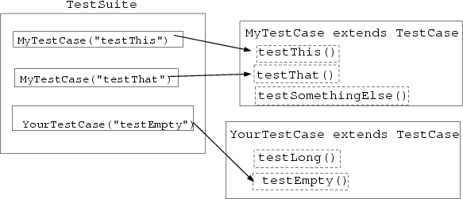
Java Unit Testing—JUnit (Contd.)

Slide 15
Java Unit Testing—JUnit Test Case
Program logic
Test Case for the program
package com.javatpoint.logic;
public class Calculation
{
public static int findMax(int arr[]){
int max=0;
for(int i=1;i<arr.length;i++){ if(max<arr[i])
max=arr[i];
}
return max;
}
}
package com.javatpoint.testcase;
import static org.junit.Assert.*; import com.javatpoint.logic.*; import org.junit.Test;
public class TestLogic
{
@Test
public void testFindMax(){ assertEquals(4,Calculation.findMax(new int[]{1,3,4,2})); assertEquals(-1,Calculation.findMax(new int[]{-12,-1,-3,-4,-
2}));
}
}
Output:
You will get an assertion error. The correct program code is in the next slide.

Slide 16
Java Unit Testing—JUnit Test Case (Contd.)
Correct code after writing a test case:
package com.javatpoint.logic;
public class Calculation
{
public static int findMax(int arr[]){ int max=arr[0];//arr[0] instead of 0 for(int i=1;i<arr.length;i++){
if(max<arr[i]) max=arr[i];
}
return max;
}
}

Slide 17
Difference between JUnit 3 and JUnit 4
JUnit 3 | JUnit 4
JUnit 3 requires JDK 1.2 or above to work. | JUnit 4 requires Java 5 or higher versions to work.
JUnit 3 does not support annotations. | JUnit 4 is fully based on annotations and provides new features “@BeforeClass” and “@AfterClass.”
In JUnit 3, the only way to ignore a test is by renaming a method. | A test can be ignored by just adding “@Ignore” annotation.
JUnit 3 does not have any timeout factor. | JUnit 4 has a new timeout factor
JUnit 3 is included in “org.junit” package. | JUnit 4 is backward-compatible and belongs to “junit.framework.”
JUnit 3 does not perform exceptional testing. | JUnit 4 performs exceptional testing using “@expected” annotations.
JUnit 3 does not include methods for comparing parity of an array and assumptions. | New methods are introduced in JUnit 4 in order to compare arrays and assumptions.
JUnit 3 does not perform parameterized tests. | JUnit 4 supports a new parameterized test runner. With this test runner, a single test with various input data can be executed.

Slide 18
Unit Testing
Topic 4—Steps involved in Adding JUnit 4 to Eclipse

Slide 19
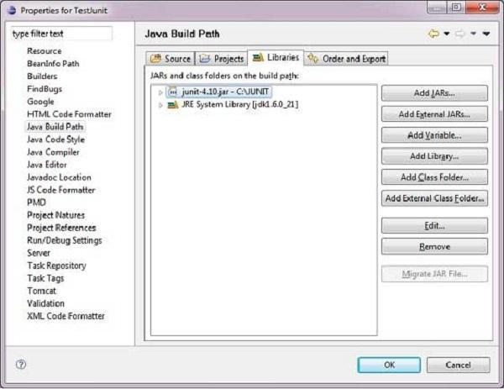
JUnit 4 to Eclipse
Open Eclipse and right click on project. Then click on property > Build Path > Configure Build Path > add
library > the junit-4.10.jar in the libraries using Add External Jar.

Slide 20
JUnit 4 to Eclipse (Contd.)
Create a project TestJunit in Eclipse at any location.
Then create a class JUnittest to test the project.
Create a test class TestJUnit
public class JUnittest
{
private String message;
//Constructor
//@param message to be printed public JUnittest(String message){
this.message = message;
}
// prints the message
public String printMessage(){
System.out.println(message); return message;
}
}
import org.junit.Test;
import static org.junit.Assert.assertEquals;
public class TestJUnit
{
String message = "Hello World";
JUnittest junittest = new JUnittest(message);
@Test
public void testPrintMessage() { assertEquals(message,junittest.printMessage());
}
}

Slide 21
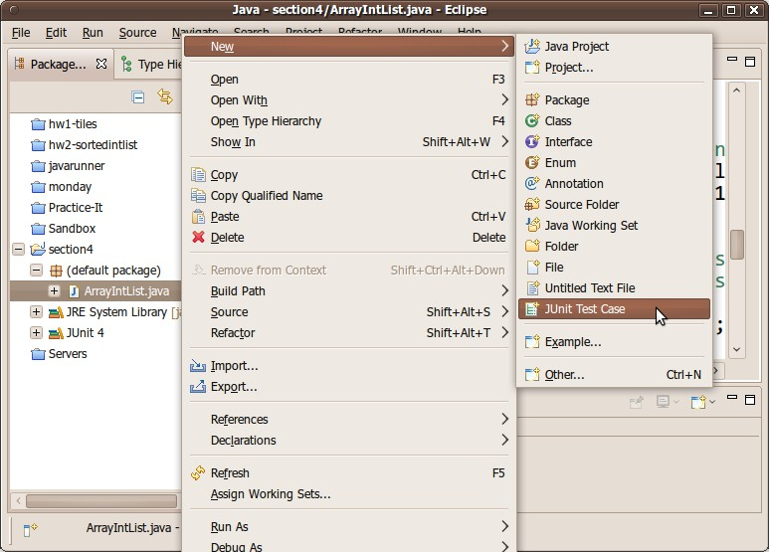
JUnit 4 to Eclipse (Contd.)
To create a new test case, select new in JUnit test case in a class.

Slide 22
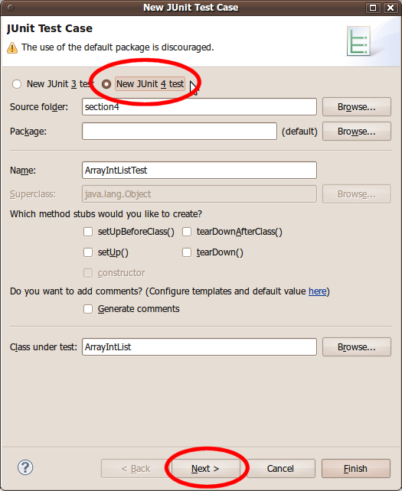
JUnit 4 to Eclipse (Contd.)
A dialog box will pop up to help you create your test case. Make sure that the option at the top is set to JUnit 4, not JUnit 3. Click Next. Then click on finish.

Slide 23
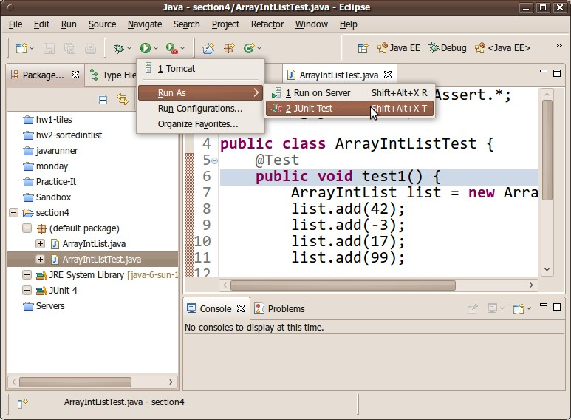
JUnit 4 to Eclipse (Contd.)
To run your test case, follow the steps below.

Slide 24
Unit Testing
Topic 5—Garbage Collection

Slide 25
Garbage Collection
Garbage collection is the process of looking at heap memory, identifying which objects are in use and which are not, and deleting the unused objects.
Some of the examples of Garbage Collection are:
employee e = new employee(); e=null; // null by reference
employee e1 = new employee(); employee e2 = new employee();
// reference to others
new employee();
// anonymous object

Slide 26
Garbage Collection (Contd.)
You can use the gc() method to invoke the garbage collector. It performs cleanup.
public class Garbagetest1
{
public void finalize(){System.out.println(“Garbage collected");} public static void main(String args[]){
Garbagetest1 s1=new Garbagetest1(); Garbagetest1 s2=new Garbagetest1();
s1=null; s2=null; System.gc();
}
}
Output:
Garbage Collected
Garbage Collected

Slide 27
System.gc() and Runtime.gc()
System.gc() | Runtime.gc()
System.gc()internally calls Runtime.gc(). | Runtime.gc() responds as per System.gc() call
System.gc() is a class method | Runtime.gc() is an instance method
System.gc() is more convenient | Runtime.gc() is less convenient than System.gc()
System.gc() is non-native method that in turn calls the Runtime.gc() | Runtime.gc() is a native method

Slide 28

Key Takeaways
The varargs feature allows the method to accept zero or multiple arguments.
An assertion is a statement in Java programming that enables you to test your assumptions about your program.
JUnit is an open-source testing framework for java programmers. The java
programmer can create test cases and test his/her own code.
Garbage collection is the process of looking at heap memory, identifying which objects are in use and which are not, and deleting the unused objects.

Slide 29

Quiz

Slide 30

QUIZ 1
Annotation @Test was introduced from version of Junit.
a. Junit3
b.
Junit4
c.
Junit2
d.
None of above

Slide 31

QUIZ 1
Annotation @Test was introduced from version of Junit.
a. Junit3
b.
Junit4
c.
Junit2
d.
None of above
The correct answer is b. Junit4
Annotation @Test was introduced from Junit4 version of Junit.

Slide 32
QUIZ 2
Garbage collector is:
a. Background thread
b.
Deamon thread
c.
Foreground thread
d.
Jvm waits for GC to run

Slide 33
QUIZ 2
Garbage collector is:
a. Background thread
b.
Deamon thread
c.
Foreground thread
d.
Jvm waits for GC to run
The correct answer is a and b.
Garbage collector is Background thread and Deamon thread.

Slide 34


Thank You

